Slide 1
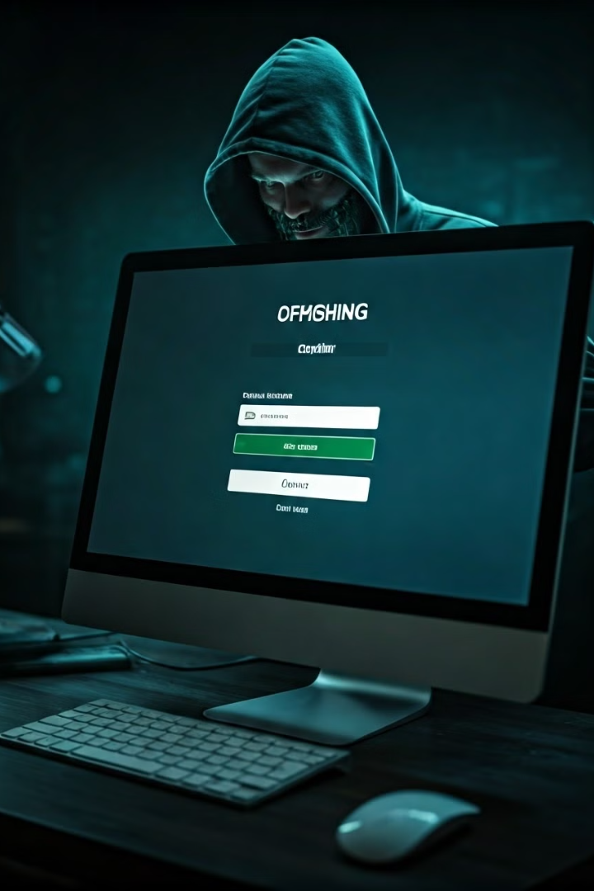
Phishing: A Digital Threat Phishing starts with a fraudulent email or other communication that is designed to lure a victim. The message is made to look as though it comes from a trusted sender. If it fools the victim, he or she is coaxed into providing confidential information, often on a scam website. Sometimes malware is also downloaded onto the target’s computer.

Slide 2
How phishing work Phishing starts with a fraudulent email or other communication that is designed to lure a victim. The message is made to look as though it comes from a trusted sender. If it fools the victim, he or she is coaxed into providing confidential information, often on a scam website. Sometimes malware is also downloaded onto the target’s computer.

Slide 3

Types of Phishing Attacks
SMS Phishing (Smishing)
Smishing is a form of phishing that uses text messages to deceive
victims. Attackers often send text messages that appear to be from a
trusted source, such as a bank or a delivery company, and ask
victims to click on a link or provide personal information
1
Email Phishing
Email phishing is the most common type of phishing attack.
Attackers send emails that appear to be from legitimate sources, such as banks, online retailers, or government agencies, but are actually designed to trick victims into clicking on malicious links or opening attachments.
2
3
Social Media Phishing
Social media phishing attacks can occur on any social media platform, including Facebook, Twitter, and Instagram. Attackers may create fake profiles or use stolen accounts to spread malicious links or request personal information from unsuspecting victims
4
Phone Phishing (Vishing)
Vishing is a form of phishing that uses phone calls to deceive victims. Attackers may call victims posing as representatives from legitimate organizations, such as banks, credit card companies, or utility providers, and ask for personal information.

Slide 4
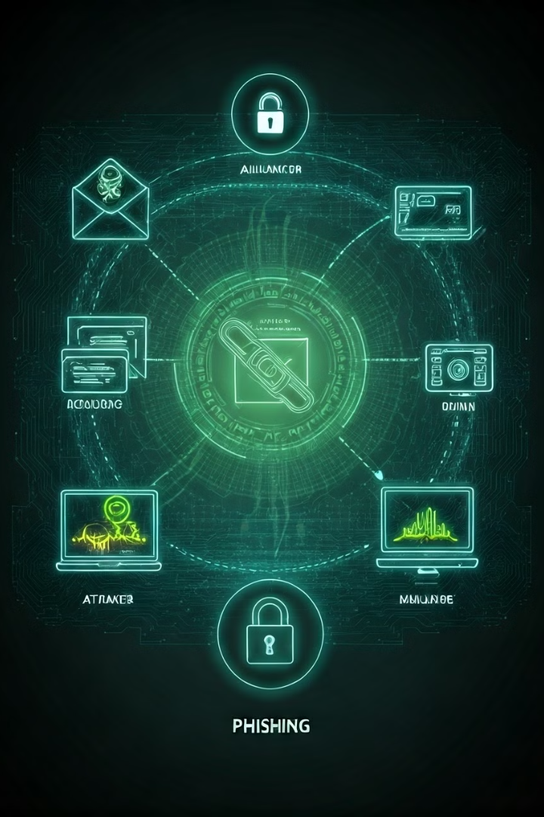
Structure of a Phishing Attack
1
Initial Contact
The phishing attack begins with an initial contact from the attacker, typically via email, text message, or social media.
2
Social Engineering
Attackers use social engineering tactics to trick victims into clicking on malicious links or opening attachments.
3
Exploitation
Once a victim clicks on a malicious link or opens a malicious attachment, the attacker can exploit vulnerabilities in the victim's system to install malware or gain access to sensitive information.
4
Data Exfiltration
The attacker then uses the compromised system to steal data, such as passwords, credit card numbers, or social security numbers, and exfiltrate it to their own systems.

Slide 5

Phishing Techniques
Spoofed Emails
Attackers often create fake emails that appear to be from legitimate sources, such as banks, online retailers, or government agencies, by spoofing the sender's email address
Fake Websites
Attackers create fake websites that mimic the look and feel of legitimate websites, such as banks, online retailers, or social media platforms, to trick victims into providing their login credentials or other sensitive information.
Social Engineering
Attackers use social engineering tactics to manipulate victims into clicking on malicious links or opening attachments by creating a sense of urgency, scarcity, or fear.
Malware
Attackers may use malware, such as keyloggers, to steal sensitive information from a victim's computer without their knowledge.

Slide 6

Identifying Phishing Attempts
Check the Sender's Email Address
Be wary of emails from unfamiliar senders or senders with email addresses that look similar to but not exactly like legitimate sources.
Look for Misspellings and Grammatical Errors
Phishing emails often contain misspellings, grammatical errors, or unusual language, which can be a sign that the email is not legitimate
Hover Over Links Before Clicking
Before clicking on any link in an email, hover over it to see the actual URL. If the URL looks suspicious or doesn't match the expected URL, don't click on it.

Slide 7



Protecting Against Phishing
User education
One way to protect your organization from phishing is user education. Education should involve all employees. High-level executives are often a target. Teach them how to recognize a phishing email and what to do when they receive one. Simulation exercises are also key for assessing how your employees react to a staged phishing attack.
Security technology
No single cybersecurity technology can prevent phishing attacks. Instead, organizations must take a layered approach to reduce the number of attacks and lessen their impact when they do occur. Network security technologies that should be implemented include email and web security, malware protection, user behavior monitoring, and access control.

Slide 8
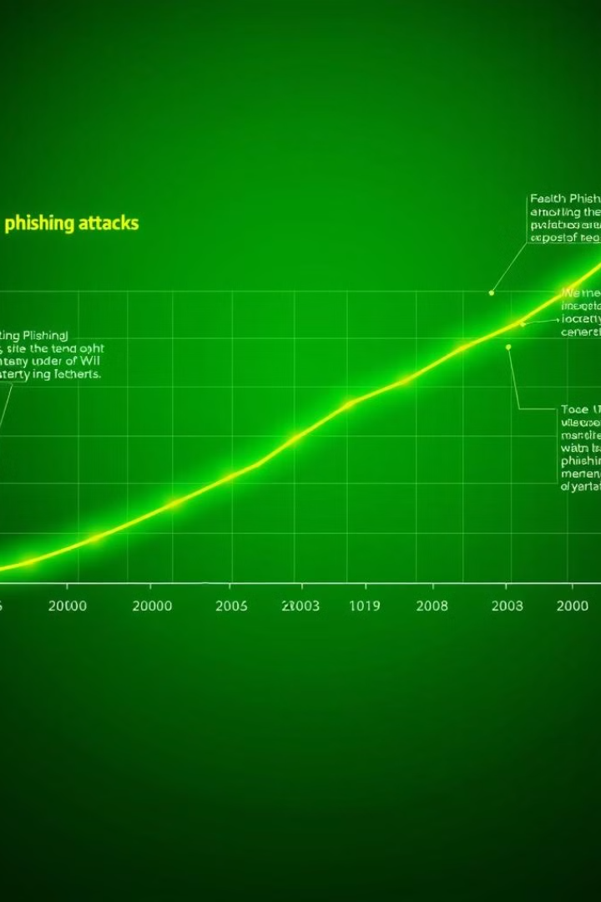
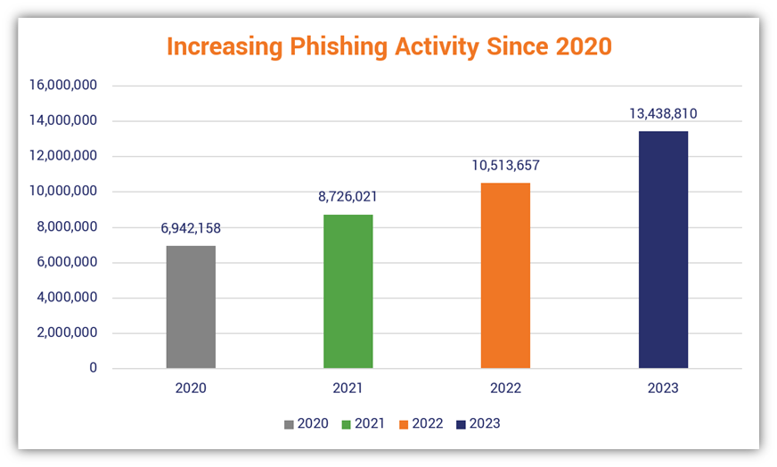
Phishing Statistics
The number of phishing attacks is increasing every year, with attackers continually developing new techniques to deceive victims.

Slide 9

Phishing Awareness and Training
1
Employee Training
Phishing awareness training starts with educating your employees on why phishing is harmful, and empowering them to detect and report phishing attempts.
2
Simulation Exercises
Simulated phishing campaigns reinforce employee training, and help you understand your own risk and improve workforce resiliency—these can take many forms, such as mass phishing, spear phishing, and whaling.
Reporting Suspicious Activity
Use the results, such as the attack types that were most successful and which teams were most vulnerable, to focus your security monitoring, strengthen your phishing awareness training, and add additional defenses for phishing protection
Best Practices
Training programs should cover best practices for identifying phishing attacks, such as checking email sender addresses and hovering over links before clicking.
3
4

